Slide 1

Fantasy Football Predictions
By: Albert Yee, Santiago Mayorga, & Sheela Tookhy

Slide 2
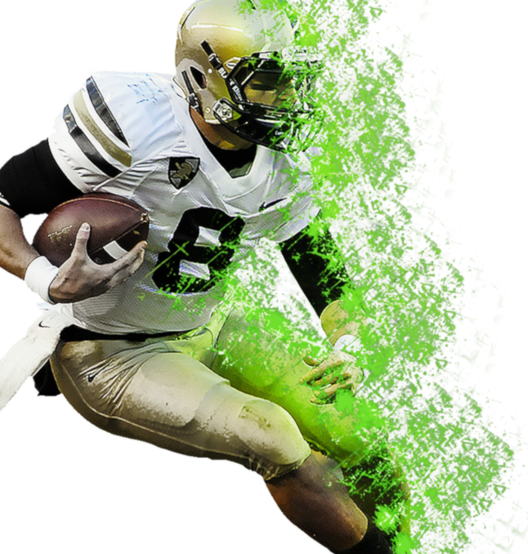
Background
01
Topics
02
Sources of Data
03
Machine Learning

Slide 3
Topics
Estimated that over 40 million individuals play fantasy football (as of August 2021)
Per Yahoo Finance, it is an industry expected to grow by $6.1 billion by 2026
Although the 2022 fantasy football pick season has already passed, we hope to answer if we could use machine learning to help predict the best players to pick for each role, as if simulating the draft at the start of a season.

Slide 4
Source Datasets
There are many websites filled with football stats out there, few offer information for free
TEXT Here
The paid sites offer up to date information, but do not need live current season data for the analysis
Used the standard PPR league scoring system
Comparing results against current season results to see how accurate the predictions were
Ultimately retrieved data from the website Pro Football Reference
Points and data from the nine separate CSV files will be joined by player name, and points from each category
Historical player data for 2019, 2020, and 2021.
CSV files of historical data on player stats for passing, rushing, and receiving yards
Determine total fantasy points per player per year

Slide 5
Cleaning the Datasets
The dataset csv files were reviewed and edited before reading them into a data frame. We have 9 input files, 1 for each year from 2019 - 2021 for passing, receiving, and rushing stats.
Remove duplicates
Remove irrelevant data
Fix structural errors
Export new csv files
Read csv files

Slide 6
Cleaning the Datasets
Read the csv files
Fix structural errors
Reading a total of 9 csv files, 1 for each year and passing, receiving and rushing stats for 2019, 2020, & 2021.
Correcting misspelling, improper capitalization, incorrect word use. Most machine learning applications can’t recognize mistakes and will skew the data
FOOTBALL
FOOTBALL
Remove duplicates/irrelevant data
Export new csv file
Removing irrelevant data which will not be used in the datasets for the predictions.
Finalizing the new data set in a cleaned dataset to use in the machine learning algorithm

Slide 7
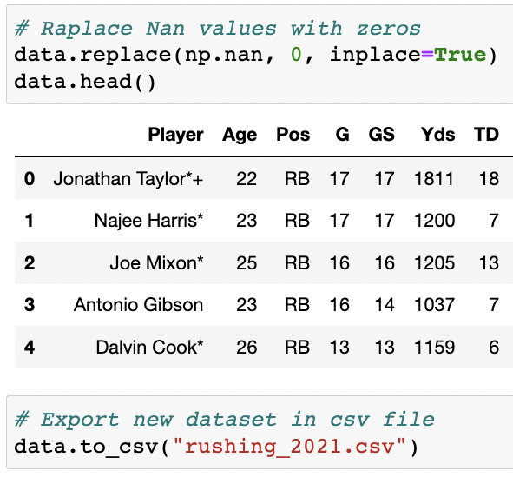
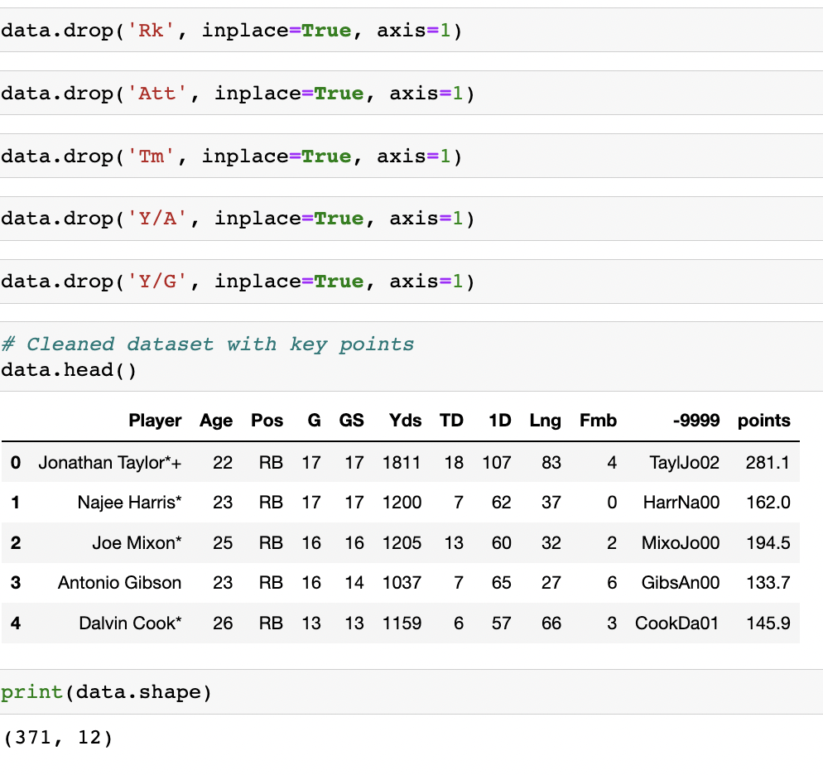
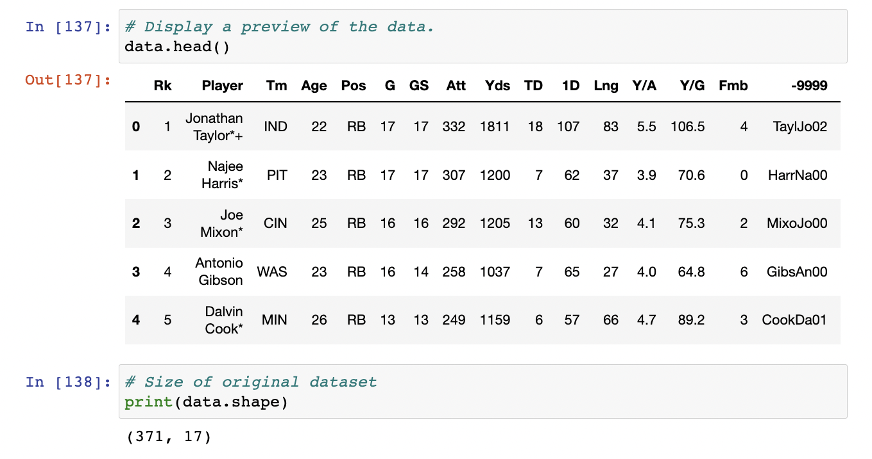
Codes
Pandas will be used to clean the data and perform an exploratory analysis

Slide 8
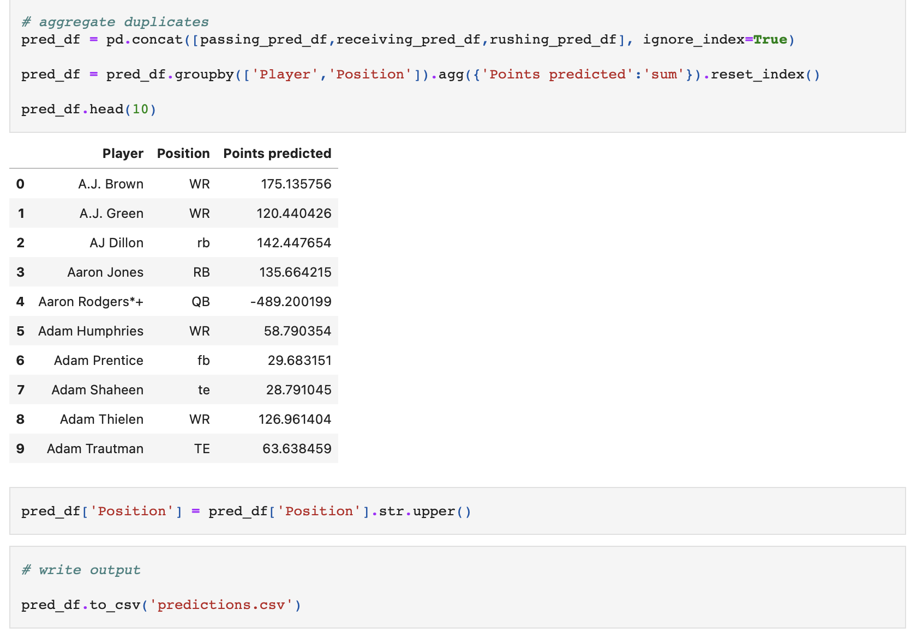
Machine Learning
SciKitLearn is the ML library we'll be using to create a classifier.
Performing linear regression on the points results for last 3 seasons by role and player
Using different algorithms to compare them against each other

Slide 9
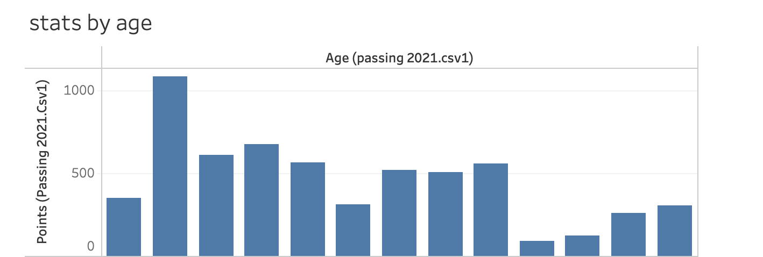
Passing Stats

Slide 10
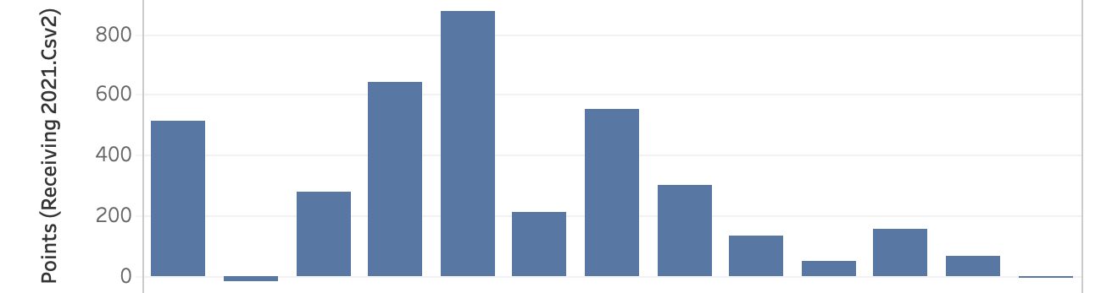
Receiving Stats

Slide 11
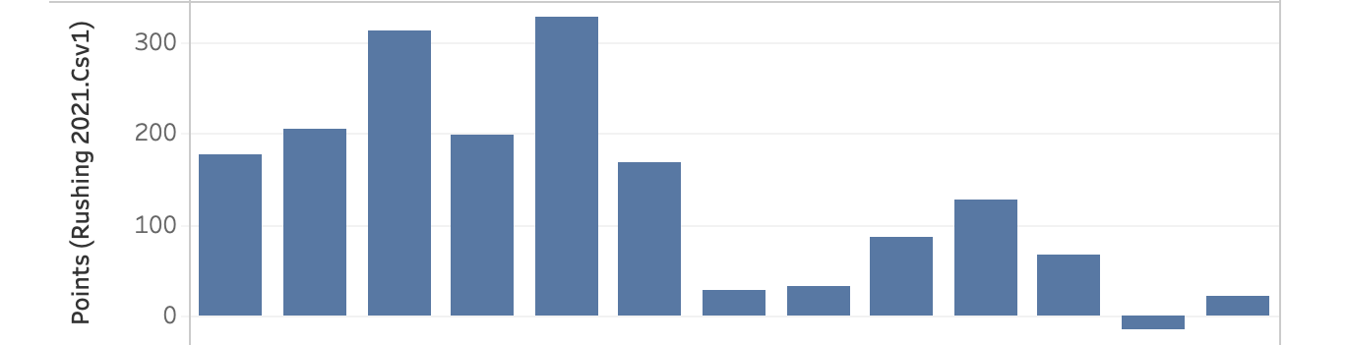
Rushing Stats

Slide 12
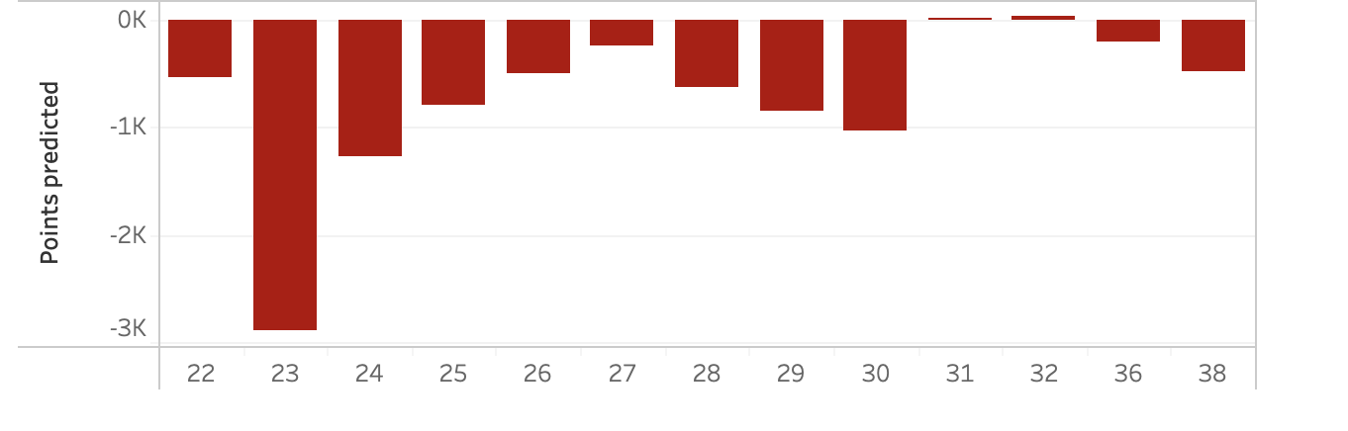
Prediction

Slide 13
Points per game
Fantasy teams are ranked based on the total points/game they accumulate weekly
Age
Age can be a contributing factor in the effectiveness of a player’s fantasy value
Player Rankings
Position
Participants complete their teams by picking players from different positions
Rating
QB fantasy points are influenced by their overall rating
Number of Yards
Offensive players are ranked based on # of yards (passing/receiving)
Points Allowed
Defensive teams are assessed based on fewest points allowed

Slide 14
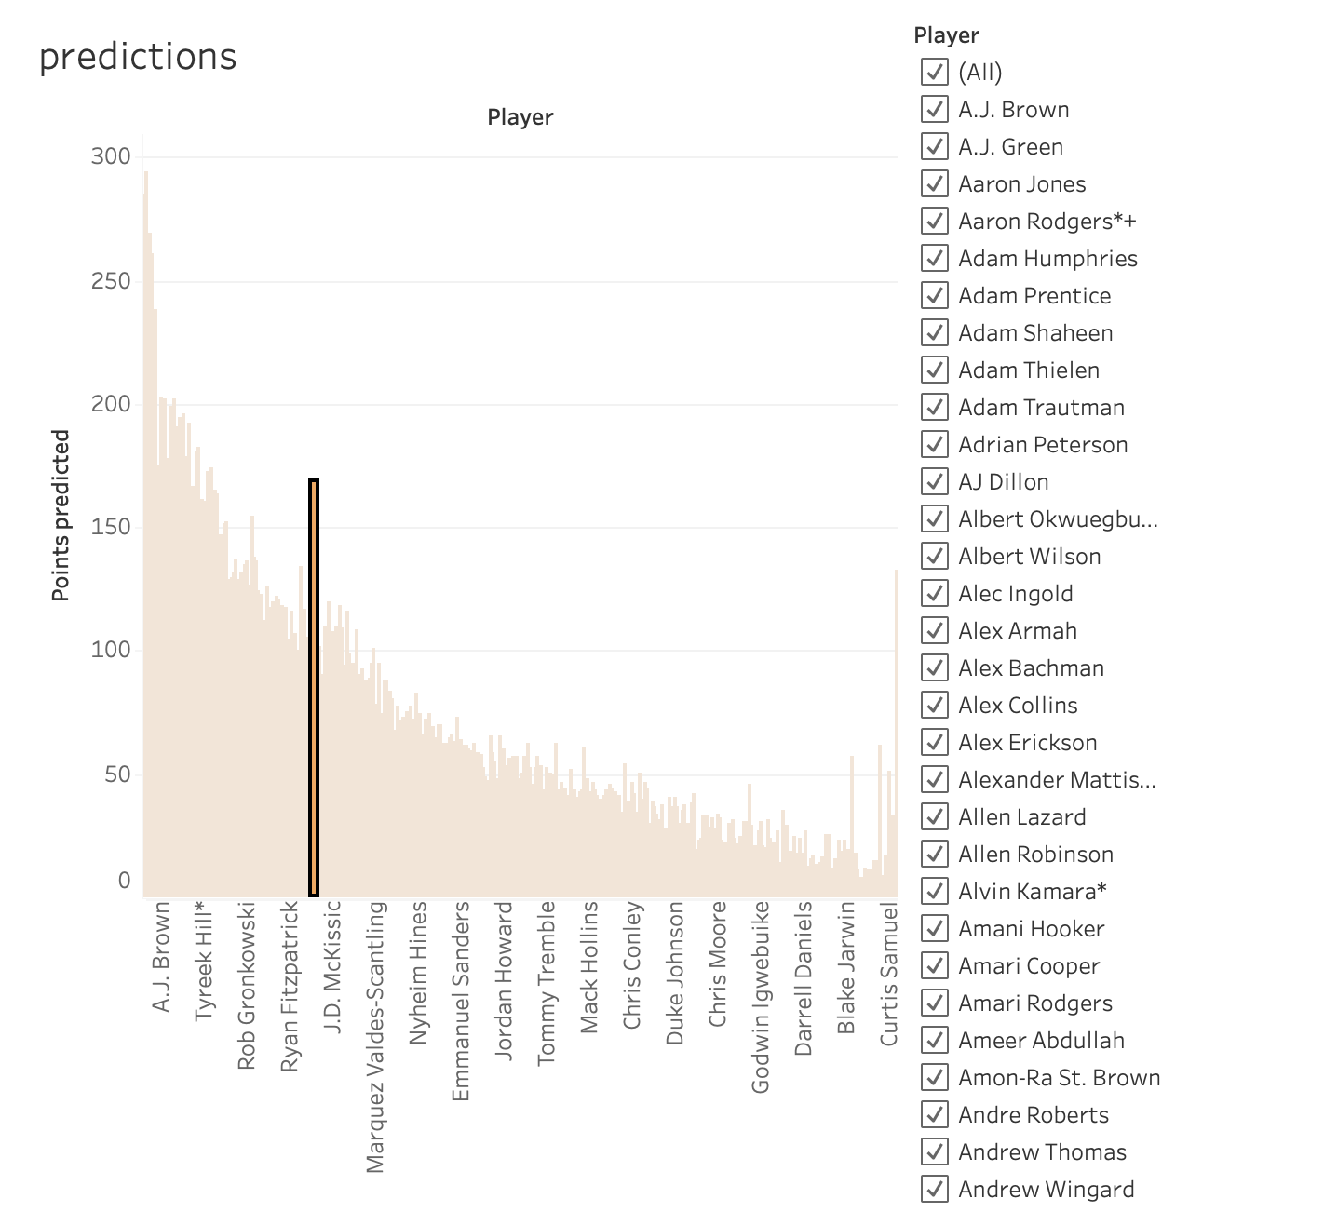

Slide 15
Fun Facts
Approximately 1.9 million teams drafted in 2018 ESPN Fantasy Football marathon
Over 27 million people play fantasy football in US & Canada
Fantasy football started in 1962
Average age of player is 34

Slide 16
Questions?

Slide 17
Thank you

